Slide 1




AlloyMax: Bringing Maximum Satisfaction to Relational Specifications
Changjian (CJ) Zhang, Ryan Wagner, Pedro Orvalho
David Garlan, Vasco Manquinho, Ruben Martins, Eunsuk Kang
Notes:
Hello everyone, my name is CJ. In this talk, I’ll briefly introduce our work AlloyMax: Bringing Maximum Satisfaction to Relational Specifications. This a joint work of researchers from Carnegie Mellon University and Institute of Systems and Computers Engineering in Lisbon.

Slide 2
What is Alloy?
Alloy: a first-order relational logic modeling language and analyzer.
Use cases:
Design Analysis: assert the behaviors of a system satisfy some property.
Model generation: generate a model satisfying some constraints.
Workflow:
Spec $S$ in FOL
Spec 𝑆 in FOL
SAT Problem
A model $M⊨S$
A model 𝑀⊨𝑆
Notes:
Alloy is a modeling language based on first-order relational logic. With its model analyzer, a FOL problem is translated into a Boolean Satisfiability problem and is solved by an off-the-shelf SAT solver. It is widely used in:
First, design analysis, for example, we can use Alloy to model the behavior of a system, and then verify that certain properties are satisfied.
Second, model generation: for example, we can use Alloy to generate a model that satisfies some given constraints.

Slide 3
Limitations of Alloy
Alloy Cannot:
Generate optimal solutions
E.g., a safe security policy that also maximizes system capability.
Specify optional constraints
E.g., (optional) user preferences in a meeting schedule problem.
Specify priorities for constraints
To resolve conflicts between multiple optimization goals.
Notes:
However, there are three limitations of Alloy:
First, it cannot generate optimal solutions to a problem. For example, generate a safe security policy that also maximizes system capability.
Second, it cannot specify optional constraints, for example, define optional user preferences in a meeting schedule problem.
Third, it cannot specify priorities for constraints, which can be used to resolve conflicts between multiple optimization goals.
In this work, we present an extension to Alloy that addresses these limitations.

Slide 4
Example: Course Scheduling
A course scheduling system:
Each student must take at least 3 courses;
Each student must take all their core courses;
A student must not take courses whose lecture times conflict.
Notes:
Let’s go through an example! Suppose we are building a course scheduling system where:
First, Each student must take at least 3 courses, and Second, each student must take all their core courses, finally, a student must not take courses whose lecture times conflict.

Slide 5
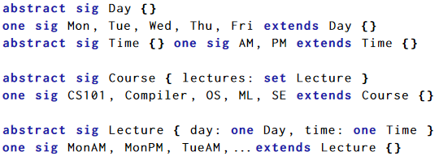
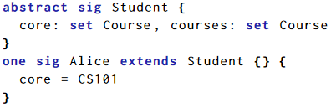
Alloy Spec
Define:
Day and Time
Courses
Lecture times
Students
Notes:
Here we provide an overview of the Alloy spec, details of the model can be found in the paper. We first define the atoms needed for the problem.

Slide 6
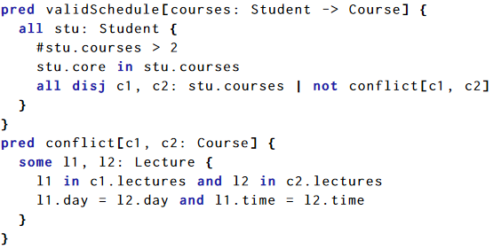
Alloy Spec
R1: Number of courses
R2: Must take core courses
R3: No time conflicts
Notes:
Then, we define the three system requirements as a predicate, named validSchedule.

Slide 7

An arbitrary valid solution
 | Mon | Tue | Wed | Thu | Fri
AM | CS101 | ML/Compiler | CS101 | ML/Compiler
PM | SE | OS | SE | OS | CS101
Alloy:
run {
validSchedule[courses]
}
Core course: CS101
Alice
Predicate for the 3 requirements
Notes:
Now, suppose the CS department of CMU is offering 5 courses. And we have a student Alice who must take CS101 as a core course. We can use Alloy to generate a valid but arbitrary solution, i.e., the predicate which defines the three requirements should be true.

Slide 8
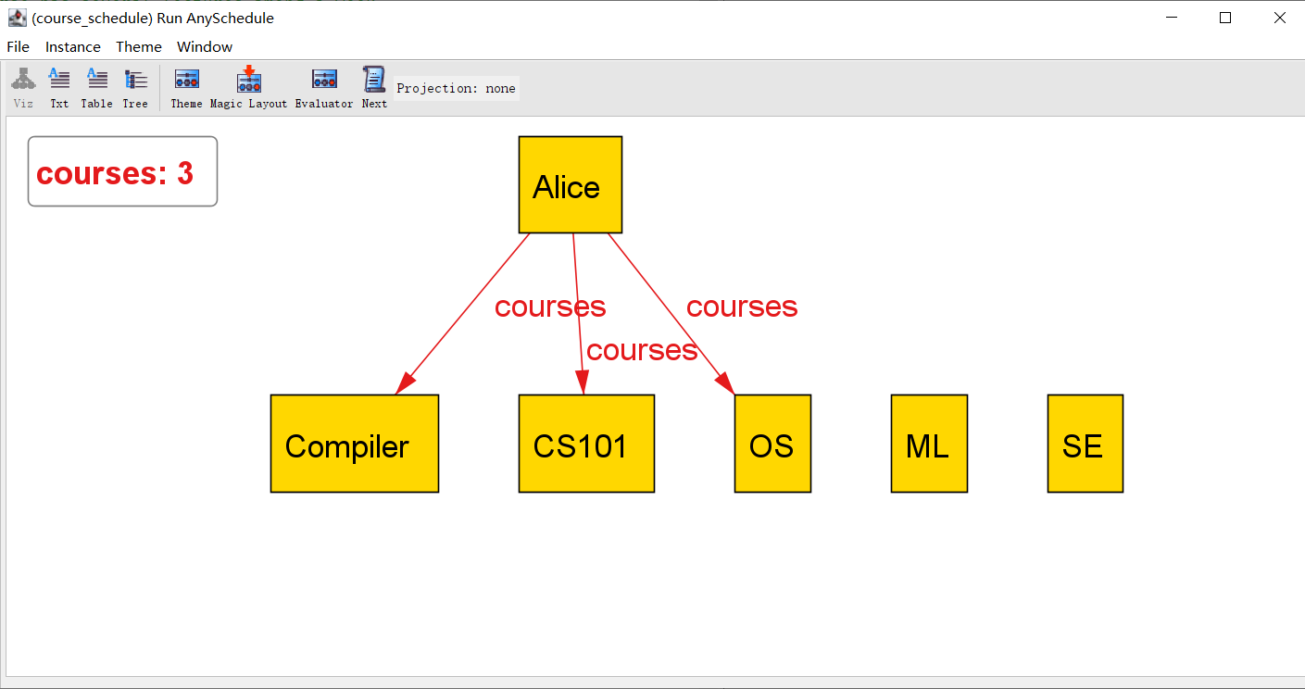
An arbitrary valid solution
 | Mon | Tue | Wed | Thu | Fri
AM | CS101 | ML/Compiler | CS101 | ML/Compiler
PM | SE | OS | SE | OS | CS101
Alloy:
run {
validSchedule[courses]
}
Core course: CS101
Alice
Predicate for the 3 requirements
Notes:
By running the analyzer, it returns a solution that Alice could take CS101, Compiler, and OS. And here’s a screenshot from Alloy.

Slide 9
Maximizing students’ interests
 | Mon | Tue | Wed | Thu | Fri
AM | CS101 | ML/Compiler | CS101 | ML/Compiler
PM | SE | OS | SE | OS | CS101
Alloy:
Interests: ML and SE
Alloy cannot solve this optimization problem!
Alice
Notes:
Then, suppose we also model the personal course preferences into the system, and Alice is interested in ML and SE. We expect the system to generate a solution that satisfies the course requirements and also maximizes students’ interests.
This becomes an optimization problem, that is we want to maximize the number of registered courses that a student is interested in. However, Alloy cannot solve such an optimization problem.

Slide 10
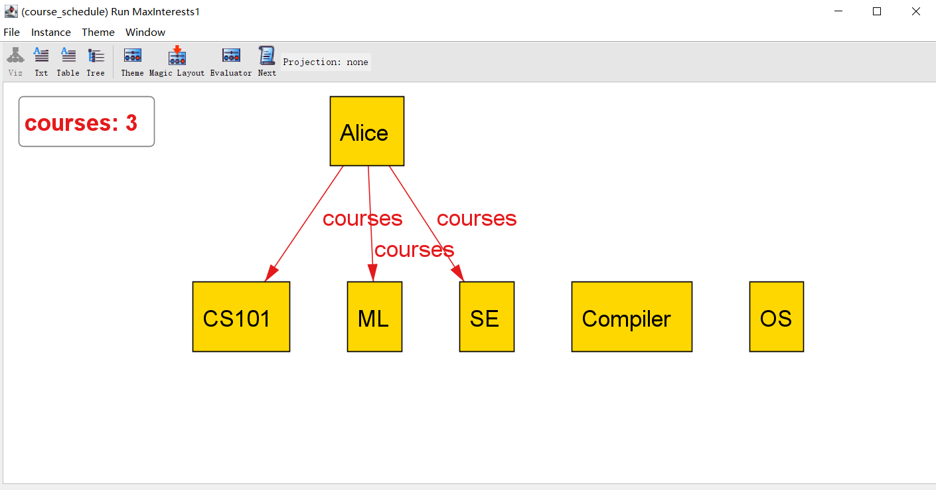
Maximizing students’ interests
 | Mon | Tue | Wed | Thu | Fri
AM | CS101 | ML/Compiler | CS101 | ML/Compiler
PM | SE | OS | SE | OS | CS101
Our extension:
run {
validSchedule[courses]
all s: Student | maxsome s.interests & s.courses
}
Interests: ML and SE
Alice
Maximizing the interests!
Notes:
In our extension, we can solve this problem by adding a new expression, i.e., for any student, there should be some courses that the student is interested in are registered. Moreover, we introduce the new keyword maxsome indicating that it should maximize these courses for each student. By solving this problem, our extension returns a solution where both ML and SE are registered. Here’s the screenshot from our extension where ML and SE are registered.

Slide 11
Adding time preferences
 | Mon | Tue | Wed | Thu | Fri
AM | CS101 | ML/Compiler | CS101 | ML/Compiler
PM | SE | OS | SE | OS | CS101
UNSAT! CS101 on Fri afternoons.
Our extension:
fact {
FreeOnFriPM[Alice, courses]
FreeOnThuAM[Alice, courses]
}
run {
validSchedule[courses]
all s: Student | maxsome s.interests & s.courses
}
Time pref.: be free on
Thu mornings,
Fri afternoons.
Alice
Notes:
Moreover, we’d like to add time preferences to the model. Alice wants to be free on Thu mornings and Fri afternoons.
We can add these constraints to the model, however, the problem becomes UNSAT.
Because recall that CS101 is a core course for Alice, which has lectures on Friday afternoons.

Slide 12
Adding soft time preferences
 | Mon | Tue | Wed | Thu | Fri
AM | CS101 | ML/Compiler | CS101 | ML/Compiler
PM | SE | OS | SE | OS | CS101
Our extension:
soft fact {
FreeOnFriPM[Alice, courses]
FreeOnThuAM[Alice, courses]
}
run {
validSchedule[courses]
all s: Student | maxsome s.interests & s.courses
}
Optional constraints!
Time pref.: be free on
Thu mornings,
Fri afternoons.
Alice
Notes:
To address this, we use the soft fact keyword in our extension to make the time preferences optional. We get a solution that Alice could take CS101, SE, and OS where she could be free on Thu mornings but has to take CS101 on Fri afternoons.
However, in this solution, Alice has to give up on ML which is her interest. The reason is that the two optimization goals conflict, ML has a lecture on Thu mornings, between maximizing the course interests and time preferences. The solver randomly pick one.

Slide 13
Solving with priorities
 | Mon | Tue | Wed | Thu | Fri
AM | CS101 | ML/Compiler | CS101 | ML/Compiler
PM | SE | OS | SE | OS | CS101
Our extension:
soft fact {
FreeOnFriPM[Alice, courses]
FreeOnThuAM[Alice, courses]
}
run {
validSchedule[courses]
all s: Student | maxsome[1] s.interests & s.courses
}
My heart is in the work!
- Andrew Carnegie
Taking courses has a higher priority.
Alice
Notes:
To resolve the conflict, we can assign priorities. In this model, keyword maxsome[1] indicates that maximizing course interests has a higher priority than time preferences. By running this model, Alice has to give up on all her time preferences in order to satisfy the department requirements and her personal course interests.

Slide 14
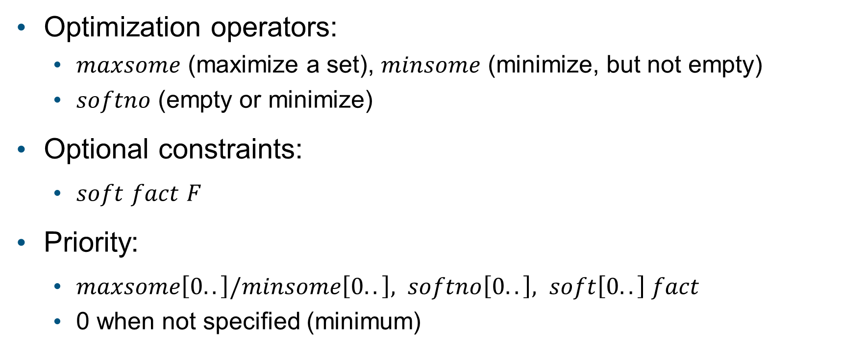
New features
Optimization operators:
$maxsome$ (maximize a set), $minsome$ (minimize, but not empty)
$softno$ (empty or minimize)
Optional constraints:
$soft$ $fact$ $F$
Priority:
$maxsome\left[0..\right]/minsome\left[0..\right], softno\left[0..\right], soft\left[0..\right] fact$
0 when not specified (minimum)
Notes:
To summarize our new features: We introduce keywords maxsome and minsome to maximize and minimize the number of elements of a non-empty set; We also introduce softno to minimize a set which can be empty. We introduce soft fact to define optional constraints. Finally, we can assign priorities to all these operators, the minimum priority 0 is specified when the priority is not given

Slide 15
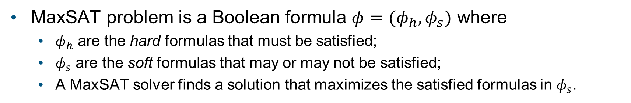
New Workflow with MaxSAT
MaxSAT problem is a Boolean formula $φ=(φ_{h},φ_{s})$ where
$φ_{h}$ are the hard formulas that must be satisfied;
$φ_{s}$ are the soft formulas that may or may not be satisfied;
A MaxSAT solver finds a solution that maximizes the satisfied formulas in $φ_{s}$.
Spec $S$ in FOL
Spec 𝑆 in FOL
MaxSAT Problem
A model
$$M⊨S$$
A model
𝑀⊨𝑆
Boolean Formula with Priorities
Notes:
To implement these new features, we change the backend solver from SAT to MaxSAT. A MaxSAT problem is a Boolean formula that contains hard formulas that must be satisfied and soft formulas that may or may not be satisfied.
And the goal for MaxSAT is to maximize the satisfied soft formulas. And we present an approach that translate a FOL problem with optimization operators to a MaxSAT problem. Then, we can solve it by some off-the-shelf MaxSAT solver, for example, in our work, we use Open-WBO as the back-end solver.

Slide 16
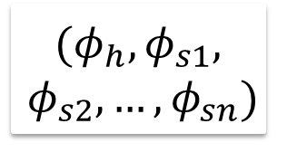
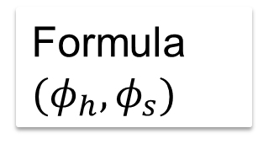
Optimization: Spec-based Partitioning
Partitioning: solve small problems and merge
Spec-based: infer partitions from Alloy spec
Formula ${(φ}_{h},φ_{s})$
Partitioner
$${(φ}_{h},φ_{s1},$$
$$φ_{s2},…,φ_{sn})$$
Solver
Optimal Solution
Solving partitions iteratively
Notes:
We also propose a new optimization technique for MaxSAT solving. Partitioning is an existing optimization technique for MaxSAT. The idea is that we can break a problem into small sub-problems and then merge the local optimal results to find a global optimal. The key is how to partition the formulas. Since in our case, the MaxSAT formula is generated from a high-level Alloy spec. We hypothesize that knowledge in the Alloy level can be used to generate better partitions than existing work, for example, in our previous course scheduling problem, we can naturally put the formulas related to maximizing course interests and the formulas related to time preferences into different partitions. We present a novel approach to leverage such high-level information to generate partitions. Interested readers can find more in the paper.

Slide 17
RQ1: How useful is our extension for modeling different types of problems?
Applied our extension to 5 case studies:
Course Scheduling (scheduling)
CheckMate (hardware security)
Graceful Degradation (software security)
Wedding Seating Problem (scheduling)
Single Machine Scheduling (OS task scheduling)
Scalability:
Alloy spec size: 50 LOC ~ 1,109 LOC
MaxSAT formula size:
Variables: 2,236 ~ 24,583,678; Clauses: 6,921 ~ 43,729,378
Solved within 30min timeout
Notes:
To evaluate our extension, we set up three research questions. First, How useful is our extension for modeling different types of problems? To answer this question, we apply our tool to 5 cases studies in different domains. Also, the generated MaxSAT problems have between 2,000 to 24 million variables and between 7,000 to 43 million clauses. All these problems can be solved in a 30 minutes timeout.

Slide 18
RQ2: Is spec-based partitioning more efficient than no-partitioning and auto-partitioning?
Auto-partitioning: graph-based clustering.
Spec-based is often better than no or auto-partitioning.
Notes:
The second research question is that: is our proposed new optimization technique, spec-based partitioning more efficient than no-partitioning and auto-partitioning. Existing work use a graph-based clustering to infer the partitions, and we expect our approach to be better. Based on our evaluation, spec-based partitioning is often better than no-partitioning and auto-partitioning, conforming that using high-level information about the problem is a useful heuristic for making the analysis more efficient.

Slide 19
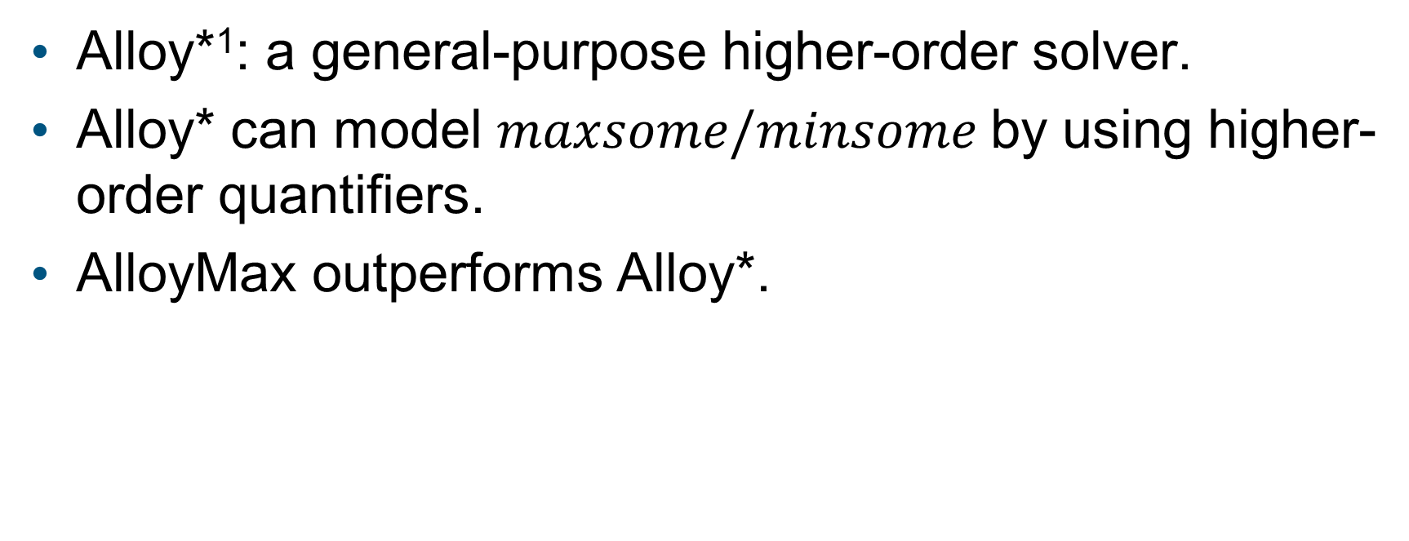
RQ3: Is our extension more efficient than Alloy* for generating optimal solutions?
Alloy*¹: a general-purpose higher-order solver.
Alloy* can model $maxsome/minsome$by using higher-order quantifiers.
AlloyMax outperforms Alloy*.
[1] Aleksandar Milicevic, Joseph P. Near, Eunsuk Kang, and Daniel Jackson. 2015. Alloy*: A General-Purpose Higher-Order Relational Constraint Solver. In 2015 IEEE/ACM 37th IEEE International Conference on Software Engineering, Vol. 1. 609–619. https://doi.org/10.1109/ICSE.2015.77
Notes:
Finally, the third research question is that is our extension more efficient than Alloy* for generating optimal solutions. Alloy* is another extension to Alloy which is designed to solve higher-order problems, so it can also be used to solve optimization problems. In our evaluation, Alloy* can model a subset of our problems, which include only maxsome or minsome operator, by using higher-order quantifiers. And the results show that , our tool AlloyMax is more efficient than Alloy* in all these problems. Alloy* cannot model optional constraints, however, on the other hand, Alloy* is a general-purpose higher order solver, it can solve problems that AlloyMax cannot.

Slide 20
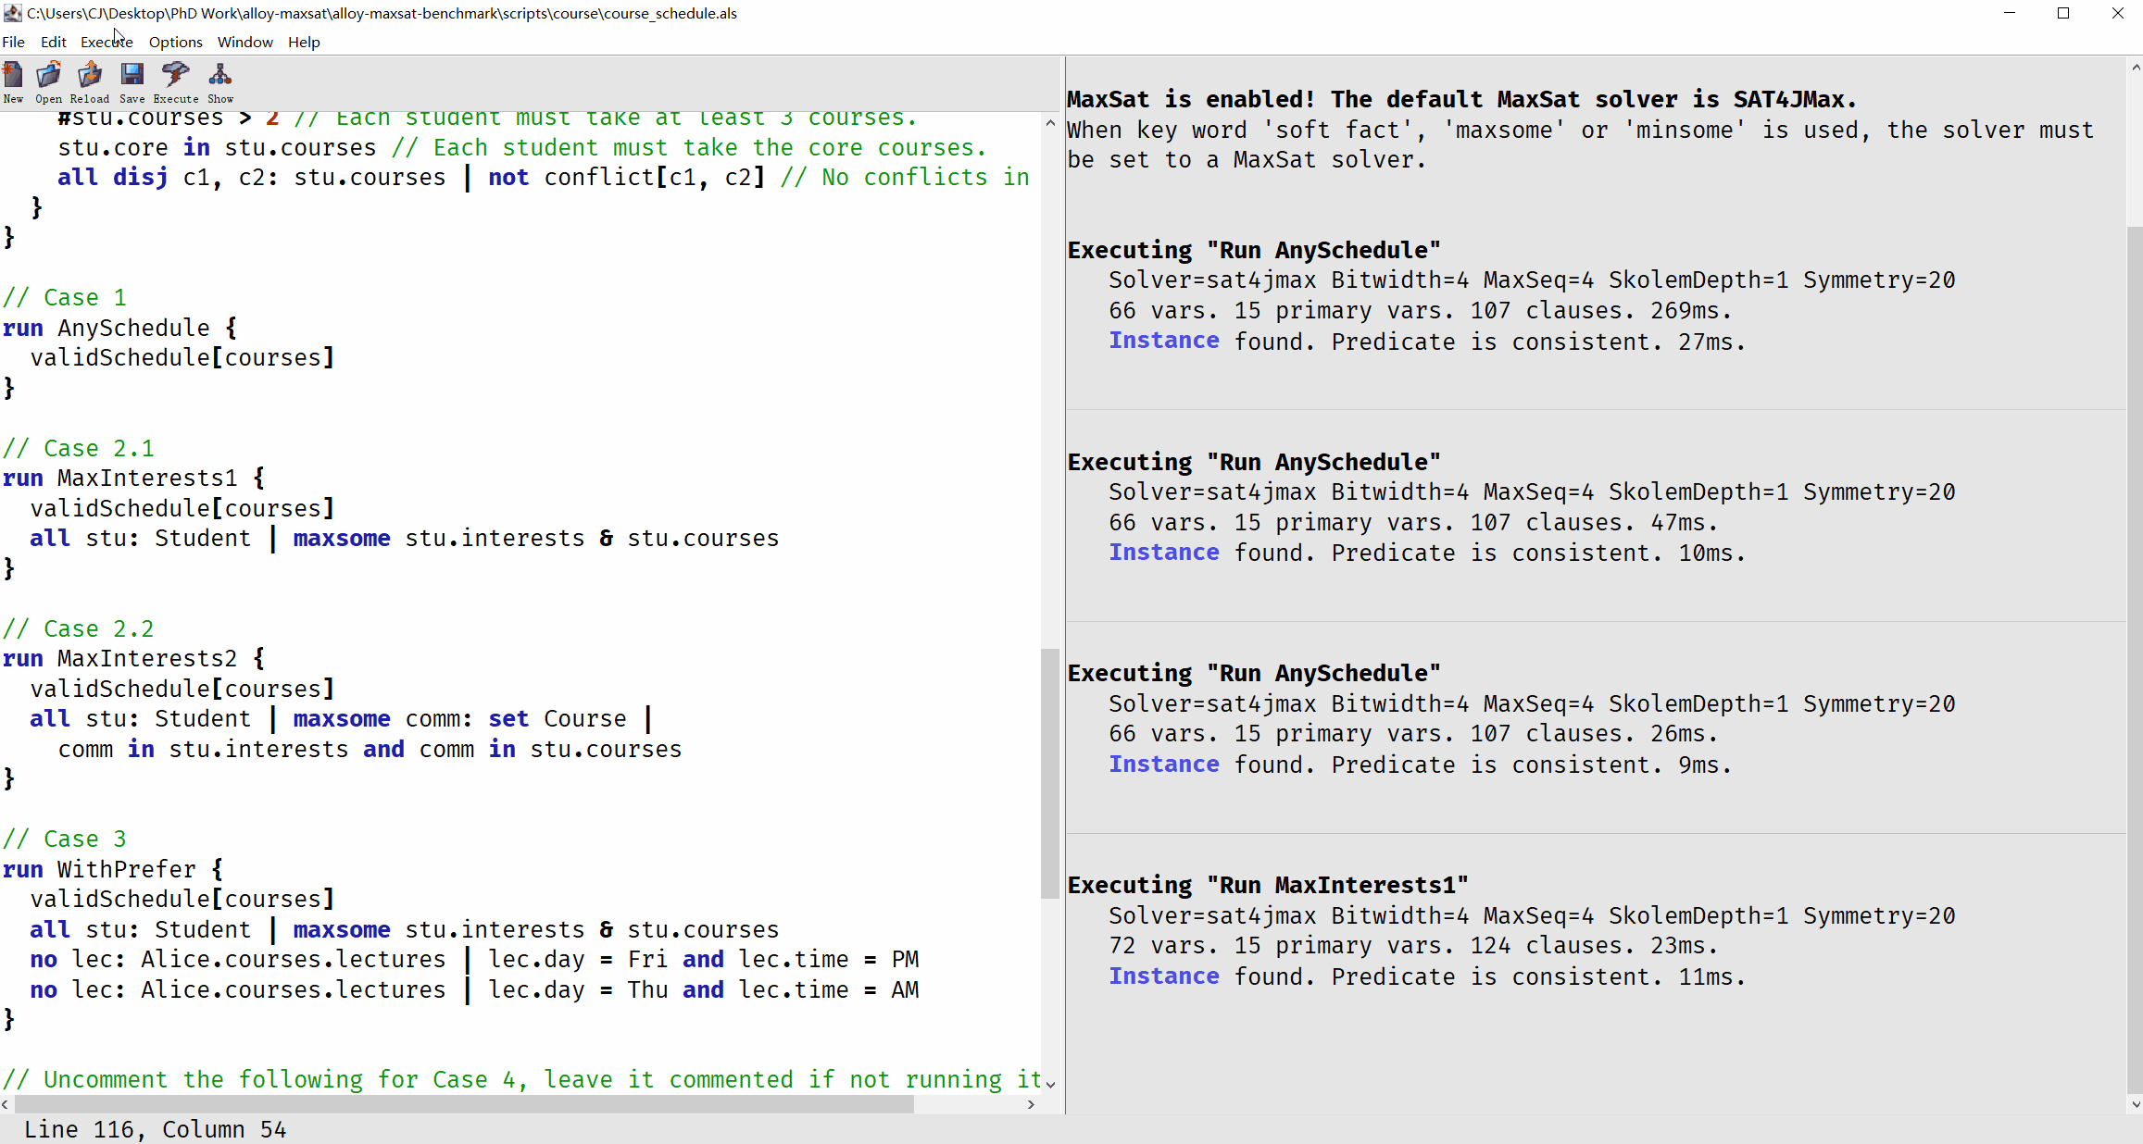
GitHub: https://github.com/SteveZhangBit/alloy-maxsat-benchmark
Thank you!
Notes:
To conclude, AlloyMax uses MaxSAT techniques to enable Alloy to solve optimization problems and define optional constraints. We also present a new optimization technique for MaxSAT solving that can leverage domain-specific information from Alloy level to partition the formulas. We will continue applying it to more real-world applications, and we believe it has the potential to solve a wide range of new problems. If you are interested in our tool, you can go to our github page to download it and try out our benchmarks. Thank you for listening!

Slide 21
Evaluation
RQ1: How useful is our extension for modeling different types of problems? Apply to 5 case studies!
RQ2: Is spec-based partitioning more efficient than no-partitioning and auto-partitioning? It depends.
RQ3: Is our extension more efficient than Alloy* for generating optimal solutions? Yes!
Notes:
To evaluate our extension, we set up three research questions.
First, RQ1, … To answer this question, we apply our extension to 5 case studies in different domains.
Second, RQ2, …. The answer to this is it depends. In 3/5 cases, spec-based partitioning is better than auto- and no-partitioning, in 1 case partitioning is not applicable, and in 1 case it is worse than no-partitioning. Readers can also find our insights on when partitioning works well in the paper.
Finally, RQ3, …. Alloy* is another extension to Alloy which is designed to solve higher-order problems, so it can also be used to solve optimization problems. Our tool AlloyMax is more efficient than Alloy* in all our case studies. However, Alloy* is a general-purpose higher order solver, it can solve problems that AlloyMax cannot.

Slide 22
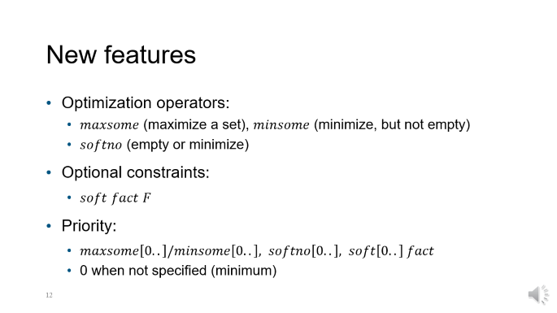
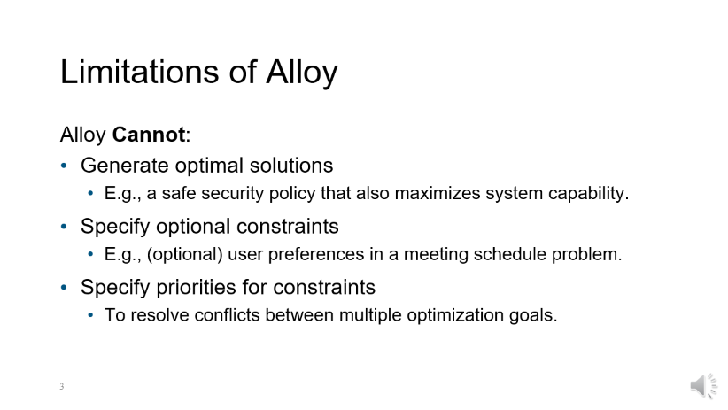
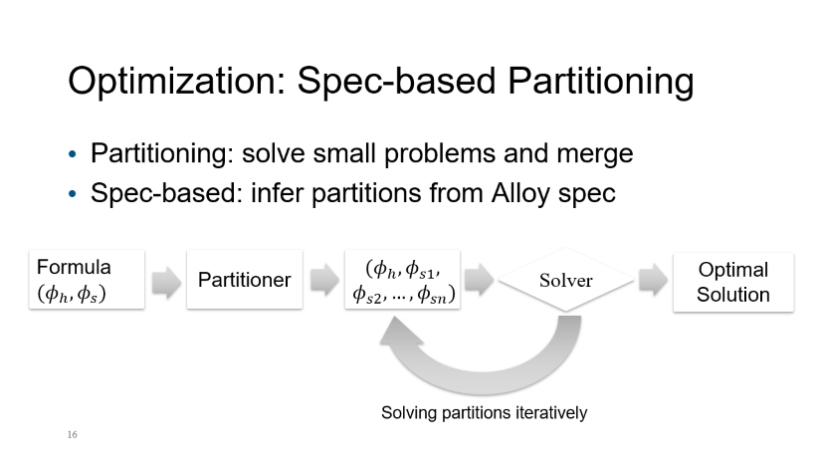
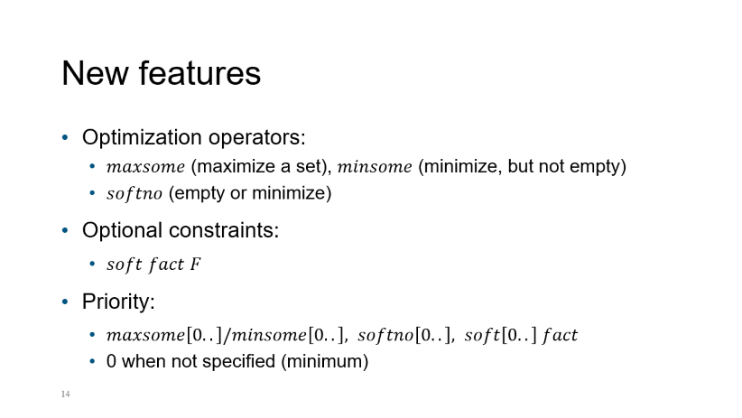
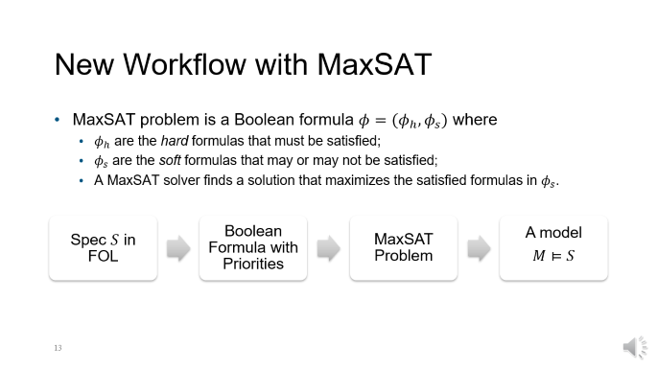

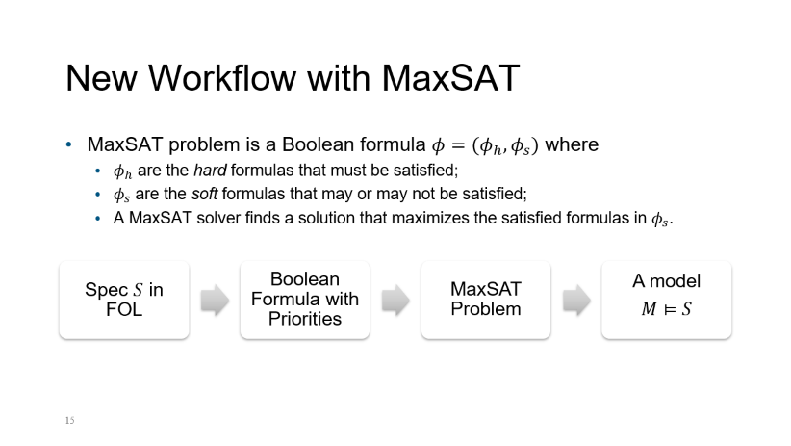
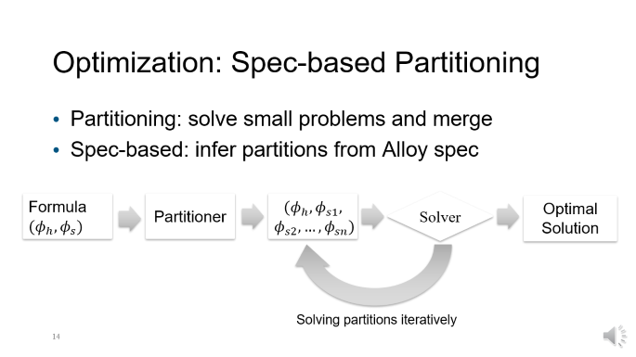
Notes:
To conclude, AlloyMax uses MaxSAT techniques to enable Alloy to solve optimization problems and define optional constraints. We will continue applying it to more real-world applications, and we believe it has the potential to solve a wide range of new problems.

Slide 23
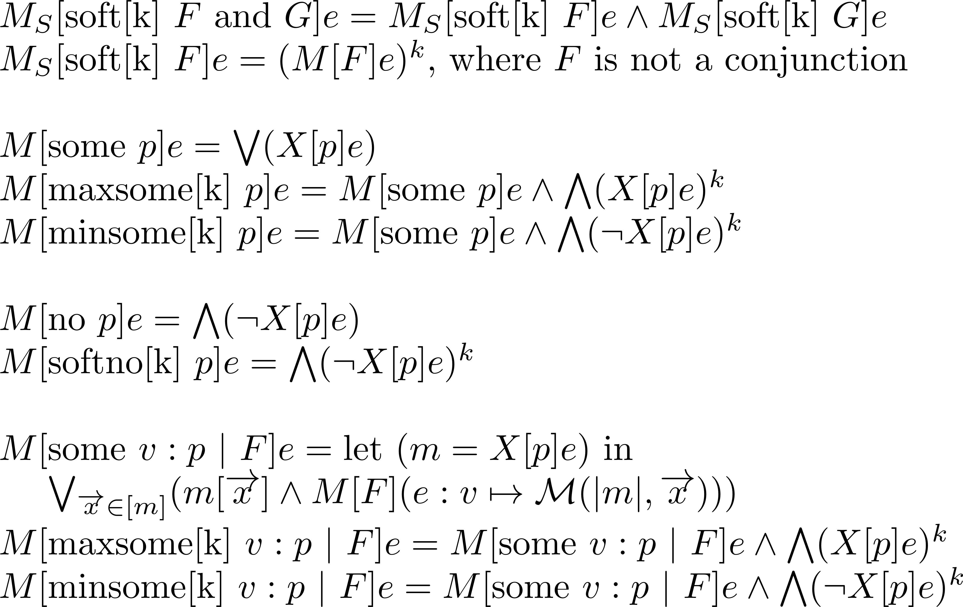
Formal Semantics
Notes:
We also provide the formal semantics and translation rules for our extension, but I will skip it for this talk.

Slide 24
Spec-based Partitioning
All hard formulas belong to group 1
Every soft constraint belongs to its own group
E.g., two groups for soft fact F and soft fact G
A new group for each optimization operator
E.g., all s: Student | maxsome s.interests & s.courses, a group for each student
Notes:
Existing work uses a graph-based auto-partitioning strategy based on the MaxSAT formulas, however, we propose a spec-based partitioning strategy that directly uses information from Alloy level, which we believe can avoid the overhead of constructing the partitions and produce better partitions. But I’ll skip the details.

Slide 25
Evaluation
RQ2: Is spec-based partitioning more efficient than no-partitioning and graph-based auto-partitioning?
Hypothesis:
Solving sub-problems is easier;
No overhead for constructing the partitions;
Better capture high-level domain knowledge (better partitions).
Notes:
Our hypothesis is that:
Solving sub-problems is easier so partitioning should be better than no-partitioning
Spec should be better than auto, because it
Does not have the overhead
Should better…

Slide 26
Evaluation
RQ3: Is our extension more efficient than Alloy* for generating optimal solutions?
Alloy* is another extension to Alloy which enables high-order analysis.
Higher-order function
Alloy*:
run {
validSchedule[courses]
no courses’: Student -> Course {
validSchedule[courses’]
some s: Student | #(s.interests & s.courses) <
#(s.interests & s.courses’)
}
}
Notes:
To maximize Alice’s course preferences, the problem can be expressed with a higher-order function, but Alloy cannot solve it. Then, alloy* is another extension which enables such analysis.
So we want to compare which one is better for this type of problem.

Slide 27
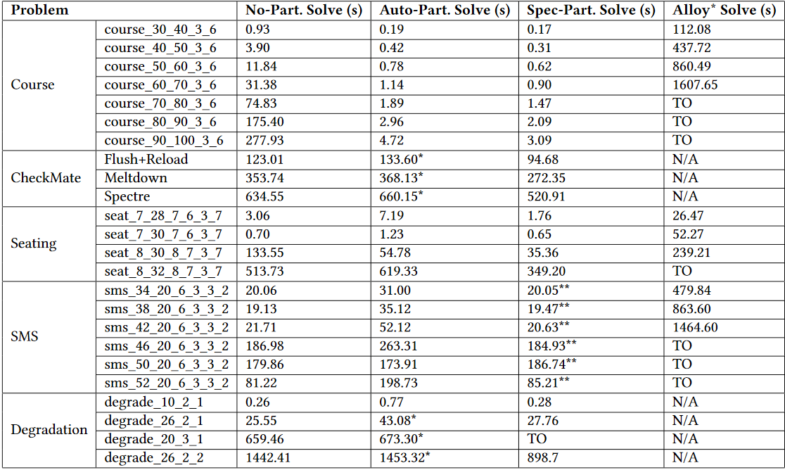
RQ2 & RQ3: Performance
Notes:
We randomly generated a benchmark for comparing the performance, but I’ll skip the details of the numbers here.

Slide 28
RQ2: observations & insights
When partition is applicable, spec-based > auto
Overhead: in 2 case studies, auto-partitioning fails, and time is wasted, because the problem is too large.
Partition effectiveness: In 1 case study, spec-based is faster than no-partitioning, but auto is slower.
Notes:
Then, for RQ2, we provide some observations and insights.
When partition is applicable, spec > auto,
In 2 cases,…
In 1 case, …, we suspect that auto-portioning fails to find effective partitions.

Slide 29
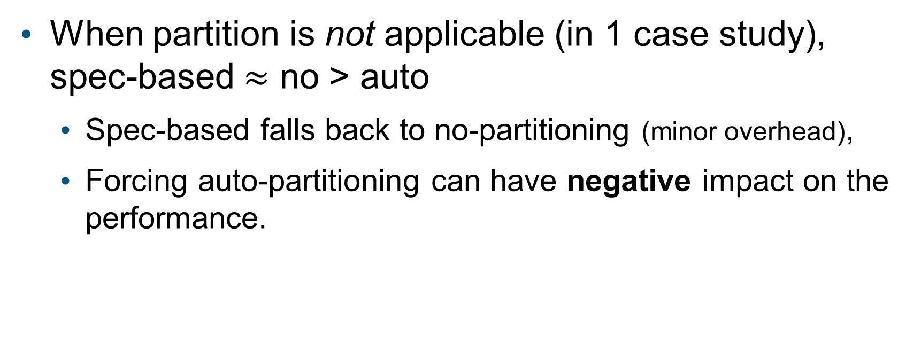
RQ2: observations & insights
When partition is not applicable (in 1 case study), spec-based $≈$ no > auto
Spec-based falls back to no-partitioning (minor overhead),
Forcing auto-partitioning can have negative impact on the performance.
Notes:
In 1 case study, partition is not applicable, in this case, spec is approximately equal to no-partition and is better than auto because …

Slide 30
RQ2: observations & insights
When partitioning works well?
Local optimal solution is part of the global optimal solution, e.g., Course Scheduling.
Every sub-problem in the iterative process contributes towards the final optimal solution (1 case study does not hold).
Notes:
Finally, we have some insights on when partitioning works well:
The first case is, <…>, in other words, we can find a global optimal solution by solving sub-problems. (like what greedy algorithm does.)
In the second case, <…>, that is, if a sub-problem does not provide any useful information towards the final optimal solution. Then, the time for this iteration is wasted, and the total overhead may be greater than the cost of solving the problem at once.

Slide 31
RQ3: vs. Alloy*
Our extension is faster in all problems.
Additionally, Alloy* is not applicable in:
1 case study containing soft constraints,
1 case study requiring a complete rewrite, which has a quantification formula with 40 variables.
Notes:
Finally, for RQ3,
In addition, Alloy* is not applicable in:
1 case study which contains soft constraints, Alloy* cannot model this type of constraint;
In another case study, Alloy* requires a complete rewrite of the spec, which has a <…>, we consider this is not practical.
In contrast, our extension only requires adding a few lines of code without changing the existing formulas.

Slide 32
Conclusion
New keywords and solving workflow for Alloy
Enable Alloy to:
Generate optimal solutions
Define and solve soft constraints
Specify priorities for multiple optimization goals.
Optimization tech: Spec-based partitioning
Notes:
To conclude our work, we introduce new keywords and solving workflow for Alloy, which enables Alloy to

Slide 33
Future work
MaxSAT uses weights instead of priority
Enable Alloy with more fine-grained weights analysis
Specify utility functions in self-* systems
Trade-off analysis
Notes:
For the future work, we’d like to further enhance the expressiveness of the language.
MaxSAT uses…
It can enable Alloy with …
Which we think could be useful in …
Thank you for listening!

